Slide 1

Stereotypes: Functions
AEPSY Year 11 ATAR Psychology

Slide 2
Review
List 3 examples of sympathetic responses and parasympathetic responses.
Name one structure that is part of the a) forebrain, b) midbrain and c) hindbrain.
What are the benefits of stratified sampling.
What are the three aspects of the tripartite model?

Slide 3
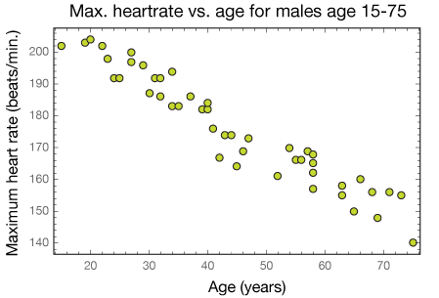
5. Refer to the graph
State the IV, DV and hypothesis for this data.
Identify the strength and direction of the relationship shown
Write this as a summary of results.
Correlation is an example of a non-directional research method. Identify 2 other types of non-experimental research methods.
Explain the difference between an experimental and a non-experimental research method.

Slide 4
Learning Intentions
stereotypes as a form of social categorisation
function of stereotypes

Slide 5
Success Criteria
Define stereotype
Give positive and negative examples of stereotypes
Explain why stereotypes are a form of social categorisation
Apply the tripartite model to stereotypes

Slide 6
Stereotypes
are cognitive schemata used to quickly and simple process large amounts of information, freeing up cognitive processing that can be used to perform other tasks.

Slide 7
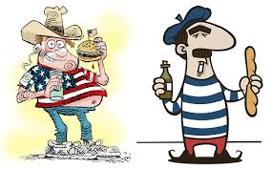
Examples of stereotypes

Slide 8
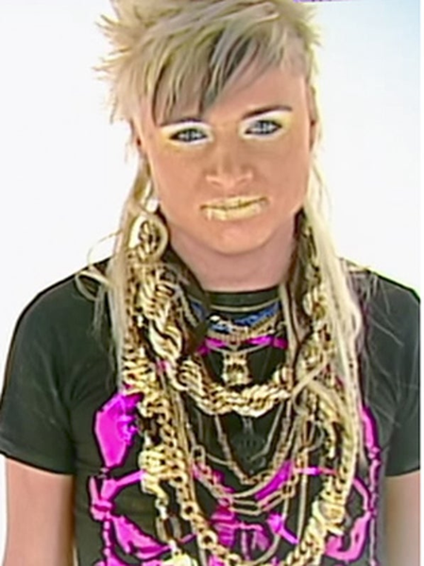

Tell me about this person…

Slide 9
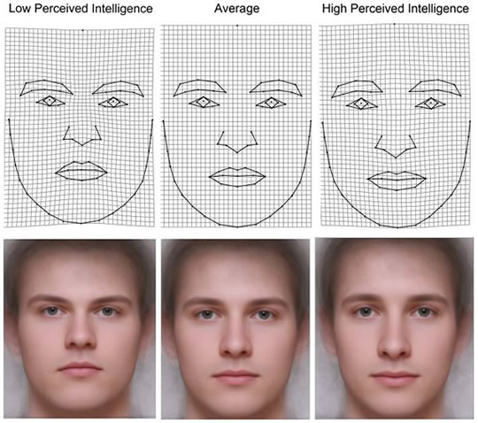
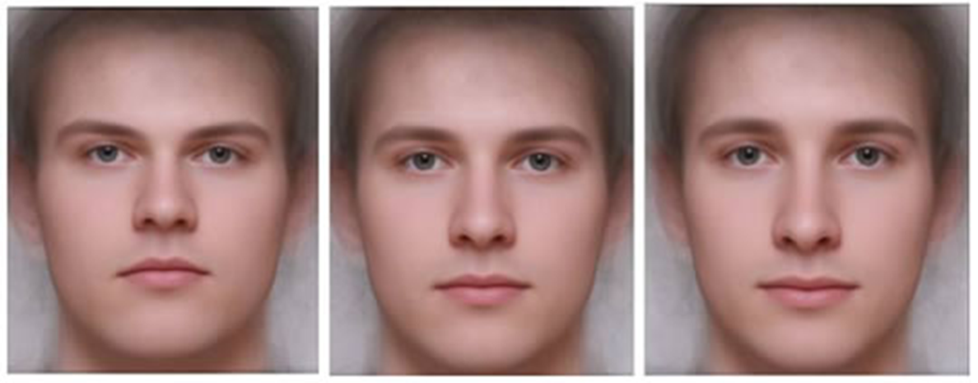
Who looks smarter?

Slide 10
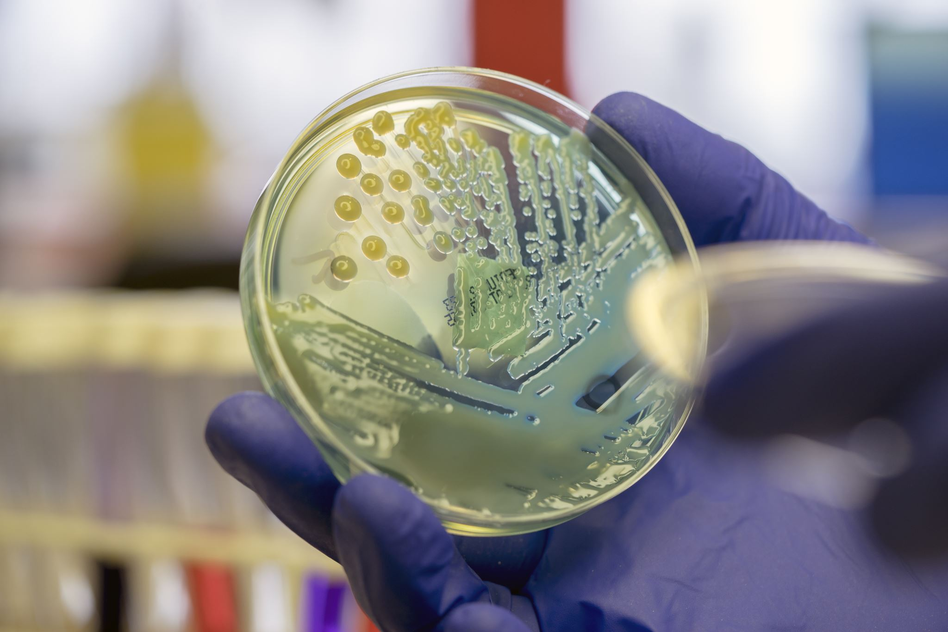
Serial Killer or Scientist

Slide 11
Evolutionary Perspective
Stereotypes may have helped people quickly assess social situations and consequently avoid danger.

Slide 12
Stereotypes are oversimplified beliefs about an outgroup pertaining to either positive or negative thoughts about its members. They are often wrong, and lead to prejudice and discrimination.

Slide 13
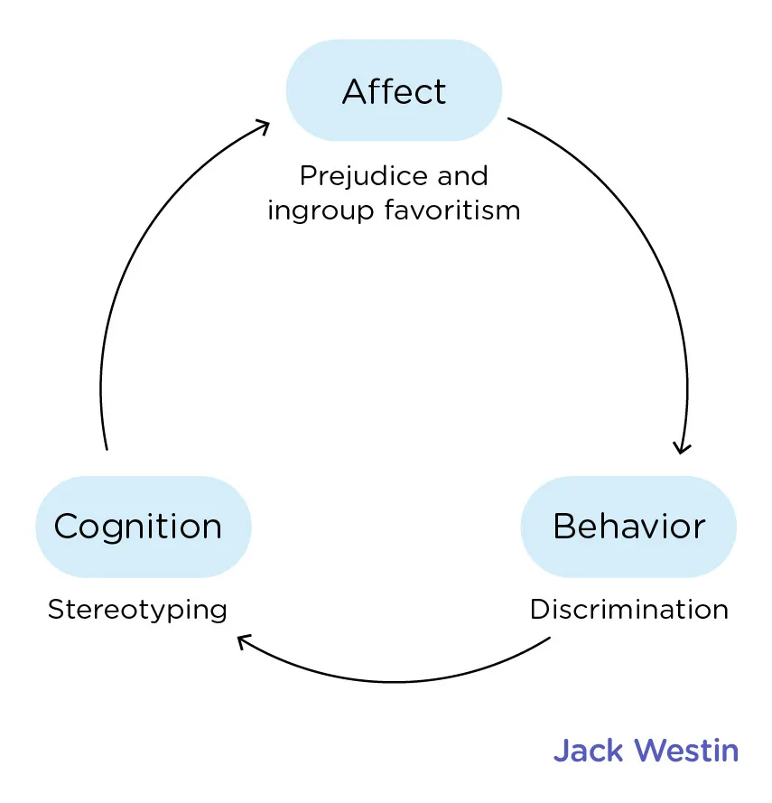
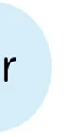
The tripartite model
Behaviour

Slide 14
Success Criteria
Define stereotype
Give positive and negative examples of stereotypes
Explain why stereotypes are a form of social categorisation
Apply the tripartite model to stereotypes

